Slide 1

DATA SCIENCE
CAPSTONE PROJECT
ANKE DE FREY
09/11/2024
HTTPS://GITHUB.COM/ANKEDEFREY/DATA-SCIENCE-CAPSTONE-PROJECT
Page 1

Slide 2

OUTLINE
P3 Executive Summary
P4 Introduction
P5 Methodology
P17 Insights drawn from EDA
P34 Launch sites proximities analysis
P39 Dashboard with plotly dash
P43 Predictive analysis (classification)
P46 Conclusion
P47 Appendix
Page 2

Slide 3
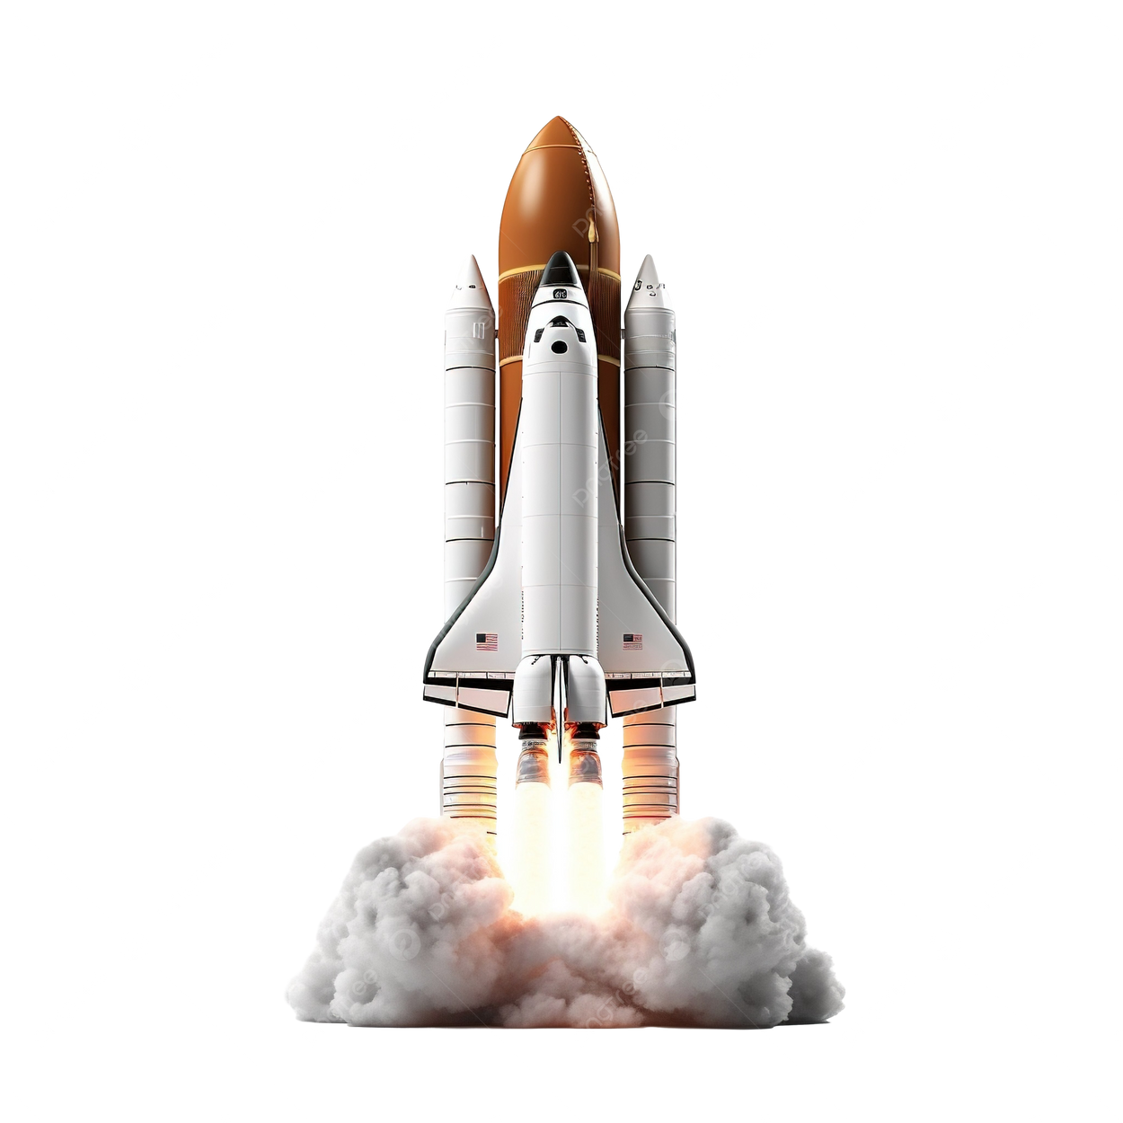
EXECUTIVE SUMMARY
Data was gathered from SpaceX API and the SpaceX Wikipedia page
A new column “class” was created to label landings as either successful or not.
The dataset was explored through SQL queries, visualization, folium maps and dashboards, with key columns chosen as features.
Categorical variables were converted to binary format with one-hot encoding and the data was standardized.
GridSearchCV was applied to fine tune the parameters of the machine learning models, and accuracy scroed for each model were displayed.
the analysis included four machine learning models: Logistic regression, Support Vector machine, Decision tree Classifier and K-Nearest Neighbors.
All models achieved a similar accuracy of 83.33% but tended to overpredict successful landings
Increasing the dataset would help enhance model performance and accuracy
Page 3

Slide 4
INTRODUCTION
Project background and context
Main objective: To Predict if the Falcon 9 first stage will land successfully
Context: SpaceX offers relatively inexpensive rocket launches ($62 million) compared to other providers ($165 million+), largely due to reusability of the first stage.
Data Collected on Space X’s Falcon 9 launches via an API.
The prediction model will help SpaceY, a new rocket company, determine competitive launch pricing.
Problems you want to find answers
Predicting first stage landing success
Develop a machine learning model to predict whether the Falcon 9 first stage will land successfully based on historical data and launch parameters (payload mass, launch site, number of flights and orbits)
Rate of successful landing over time
Best predictive model for successful landing
Page 4

Slide 5
METHODOLOGY
Page 5

Slide 6
METHODOLOGY
Summary
Data collection methodology: Via SpaceX REST API and web scraping techniques.
Perform data wrangling: Filtering data, handling missing values and applying one hot encoding
Perform exploratory data analysis (EDA) using visualization and SQL
Perform interactive visual analytics using Folium and Plotly Dash
Perform predictive analysis using classification models: How to build, tune, evaluate classification models
Page 6

Slide 7
METHODOLOGY
DATA COLLECTION
SpaceX REST API:
api.spacexdata.com/v4/launches/past
Provides detailed information about past SpaceX launches, such as the rocket used, payload delivered, launch specifications, landing specifications and the outcome of the landing.
Web Scraping (BeautifulSoup):
Alternative data source obtained through web scraping of HTML tables from related Wikipedia pages.
Beautiful soup used to parse HTML tables to extract relevant launch data.
Once data is cleaned it is transformed into a Pandas DataFrame for further analysis and visualisation.
(see flowcharts on next page)
Page 7

Slide 8





METHODOLOGY
DATA COLLECTION - SPACEX API
1
Request SpaceX API
GET request to API URL
3
Preprocess Data
Filter for Falcon 9 launches and Extract relevant columns
2
Parse the JSON response
Convert JSON to DataFrame and use json_normalize to flatten data
4
Data Enrichment
Make additional API calls and add new columns if relevant
5
Handle Missing Data
Replace missing PayloadMass values with mean
6
Filter for Falcon 9
Filter and adjust columns as needed
7
Export Cleaned Data
Convert to dictionary
https://github.com/Ankedefrey/Data-Science-Capstone-Project/blob/main/jupyter-labs-spacex-data-collection-api.ipynb
Page 8

Slide 9

METHODOLOGY
DATA COLLECTION - WEB SCRAPING
2
Parse HTML with BeautifulSoup
using html5lib parser
4
Create Empty Dictionary
for launch data
6
Convert Dictionary to DataFrame
1
Request Wikipedia HTML
(Falcon 9 launch records page
3
Find launch information table in HTML
5
Iterate through table cells
Extract Data into dictionary
https://github.com/Ankedefrey/Data-Science-Capstone-Project/blob/main/jupyter-labs-webscraping%20(1).ipynb
Page 9

Slide 10
METHODOLOGY
DATA WRANGLING
Perform Exploratory Data Analysis (EDA) and identify key labels for training data.
Calculate:
Number of Launches per Site: Analyze launch frequencies by location.
Number and Occurrence of Each Orbit Type: Determine common orbit types and their frequency.
Number and Outcome of Each Mission by Orbit Type: Summarize mission outcomes per orbit.
Create Binary Landing Outcome Column: Generate a dependent variable labeled Class to indicate landing success.
True Ocean: Successful landing in a designated ocean region.
False Ocean: Unsuccessful landing in an ocean region.
True RTLS: Successful landing on a ground pad.
False RTLS: Unsuccessful landing on a ground pad.
True ASDS: Successful landing on a drone ship.
False ASDS: Unsuccessful landing on a drone ship.
Convert Outcomes to Binary: Assign 1 for successful outcomes and 0 for unsuccessful ones in the Class column.
Export Data to CSV: Save processed data for modeling.
https://github.com/Ankedefrey/Data-Science-Capstone-Project/blob/main/labs-jupyter-spacex-Data%20wrangling.ipynb
Page 10

Slide 11
METHODOLOGY
EDA WITH DATA VISUALIZATION
https://github.com/Ankedefrey/Data-Science-Capstone-Project/blob/main/edadataviz.ipynb
Scatter plot
Shows relationships and trends between twee variables (eg. flight number vs payload mass, launch site, orbit type or payload mass vs orbit type.
Bar chart
Compares categorical data, such as success rates for each orbit type.
Line chart
Tracks changes over time, like the yearly trend of launch success.
Scatter plot
Flight Number vs Payload Mass
Flight Number and Launch Site
Payload Mass and Orbit type
Flight Number and Orbit type
Bar chart
Success rate of each Orbit type
Line chart
Launch success yearly trend
Page 11

Slide 12
METHODOLOGY
EDA WITH SQL
Queries
Display unique launch sites in the space mission
Display 5 records where launch sites begin with ‘CCA’
Calculate the total payload mass carries by boosters launched by NASA (CRS)
Calculate the averge payload mass carried by booster version F9 v1.1
List the date of the first successful landing outcome in ground pad
List boosters with successful drone ship landing and payload mass between 4000 and 6000
List the total number of successful and failed mission outcomes
List boosters carrying the maximum payload mass using a subquery
Display failure landing outcomes in drone ship for the ear 2015, with month names
Ranked landing outcomes by count between June4, 2010, and March 20, 2017, in descending order
https://github.com/Ankedefrey/Data-Science-Capstone-Project/blob/main/jupyter-labs-eda-sql-coursera_sqllite%20(1).ipynb
Page 12

Slide 13
METHODOLOGY
MAP WITH FOLIUM
https://github.com/Ankedefrey/Data-Science-Capstone-Project/blob/main/lab_jupyter_launch_site_location.ipynb
Markers for launch sites
Added folium.Circle and folium.Marker.
These objects provide a visual representation of where each SpaceX launch site is located, making it easier for users to identify launch site locations on the map. A popup label on each circle displays the site’s name for context.
Markers for Launch Success/Failure
Added folium.Marker with custom color icons, grouped using MarkerCluster.
These markers show the success (green) or failure (red) of each launch. Cluster grouping is used to manage overlapping markers when there are many launches at the same location, enhancing the map’s readability.
Proximity analysis object (Lines and Distance calculations)
Added folium.PolyLine and folium.Marker for displaying the distance from launch sites to nearby features like coastlines, cities, railways and highways.
The line connections between the launch site and these features are drawn to illustrate potential impact on the site on the selection and operations.
Distance Calculation Function
Used calculate_distance to compute the distances between two geographical points using the Haversine formula.
This calculation informs the proximity analysis and helps quantify the relationship between launch sites and nearby features
Mouse Position
Added MousePosition widget.
Provides real-time coordinates as you hover the mouse over the map, aiding in precise measurement and location identification during exploratory analysis
Page 13

Slide 14
METHODOLOGY
DASHBOARD WITH PLOTLY DASH
Dropdown for Launch Site Selection
Allows user to select a specific launch site or view data for all sites
Provides a flexible way to filter data based on site, helping users focus on particular locations
Pie chart for launch success
Displays the total number of successful launches, either across all sites or for a specific site.
It visualizes launch success vs failure, helping users assess performance by site.
Slider for Payload Range
Allows users to select a range of payloads.
Provides interactivity to filter data by payload mass, enabling users to explore how payload affects launch success.
Scatter plot for Payload vs Success
Shows the correlation between payload mass and launch success, with different booster versions.
Helps users analyze how payload size influences the likelihood of a successful launch, providing insights into the impact of payloads on success rates.
https://github.com/Ankedefrey/Data-Science-Capstone-Project/blob/main/spacex_dash_app%20(1).py
Page 14

Slide 15
METHODOLOGY
PREDICTIVE ANALYTICS
1
Data Collection and Exploration
Load the dataset and extract features and target variable
3
Model Selection
Choose candidate models: Logistic Regression, SVM, Decision Tree, KNN
5
Model Evaluation
Evaluate models using accuracy and confusion matrix to compare results to determine the best model
2
Data Preprocessing
Standardize the data and split data in training and test sets
4
Hyperparameter Tuning
Use GridSearch for each model to find the best hyperparameter
6
Final Model
Select the model with the highest accuracy
https://github.com/Ankedefrey/Data-Science-Capstone-Project/blob/main/SpaceX_Machine%20Learning%20Prediction_Part_5.ipynb
Page 15

Slide 16
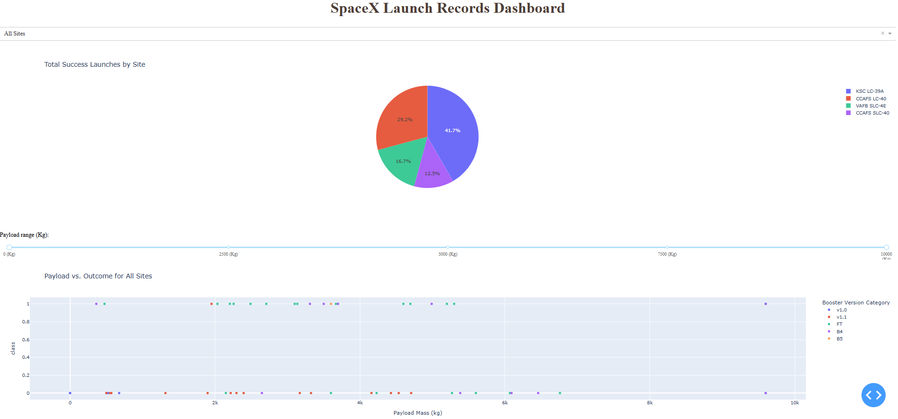
RESULTS
Page 16

Slide 17
INSIGHTS DRAWN FROM EDA
VISUALISATION
SQL
Page 17

Slide 18
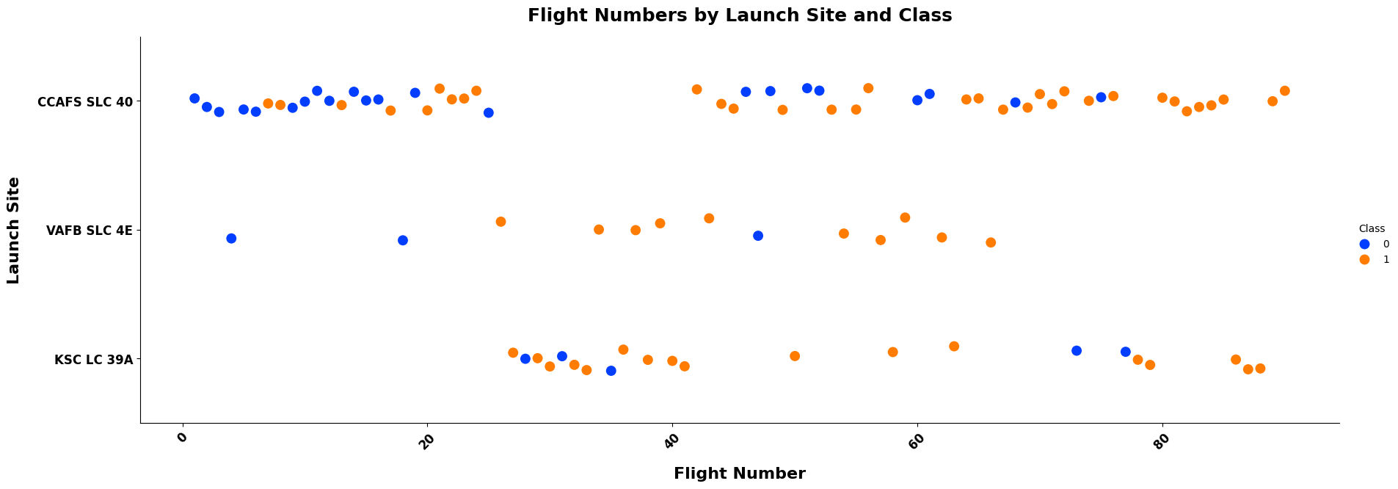
VISUALIZATION
FLIGHT NUMBER VS LAUNCH SITE
Blue indicates failed launches and orange indicates successful launches.
CCAFS SLC 40 contains highest volume of launches although not the most successful launches compared to volume.
KSC LC 39A is by far the most successful where only 5/22 launches being unsuccessful.
Visualization suggests an increase in success rate as number of flights increases.
Page 18

Slide 19
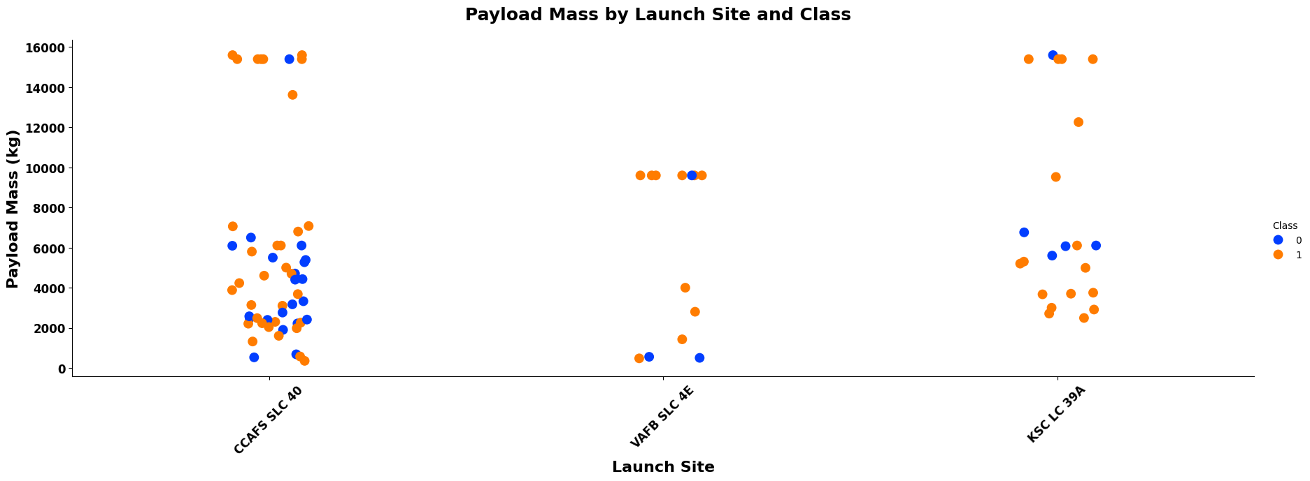
VISUALIZATION
PAYLOAD VS LAUNCH SITE
Most launches above ~8000kg where successful
KSC LC 39A has a perfect success rate for launches under ~5000kg. Between ~5500kg - ~8000kg most of the launches are unsuccessful.
VAFB SKC 4E did not launch anything above 10 000kg seeming that they found success at 10 000kg with only one failed launch.
Thus, the higher the payload mass, the higher the success rate, excluding KSC LC 39A from this statement.
Page 19

Slide 20
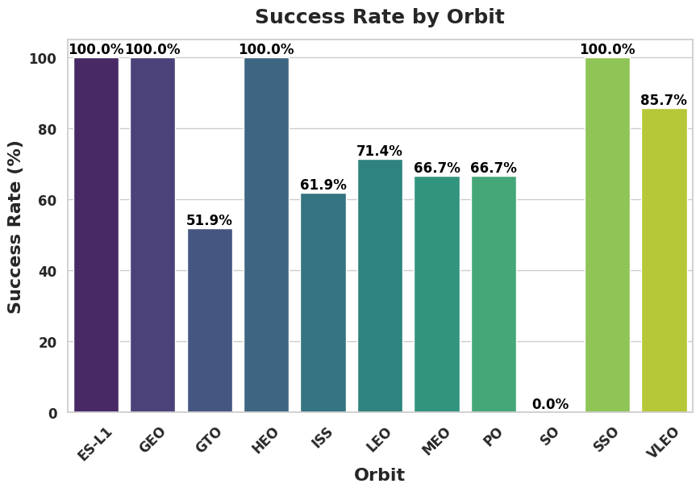
VISUALIZATION
SUCCESS RATE VS ORBIT TYPE
ES-L1, GEO, HEO, SSO 100% success rate.
GTO, ISS, LEO, MEO, PO 50-80% success rate.
SO 0% success rate
Page 20

Slide 21
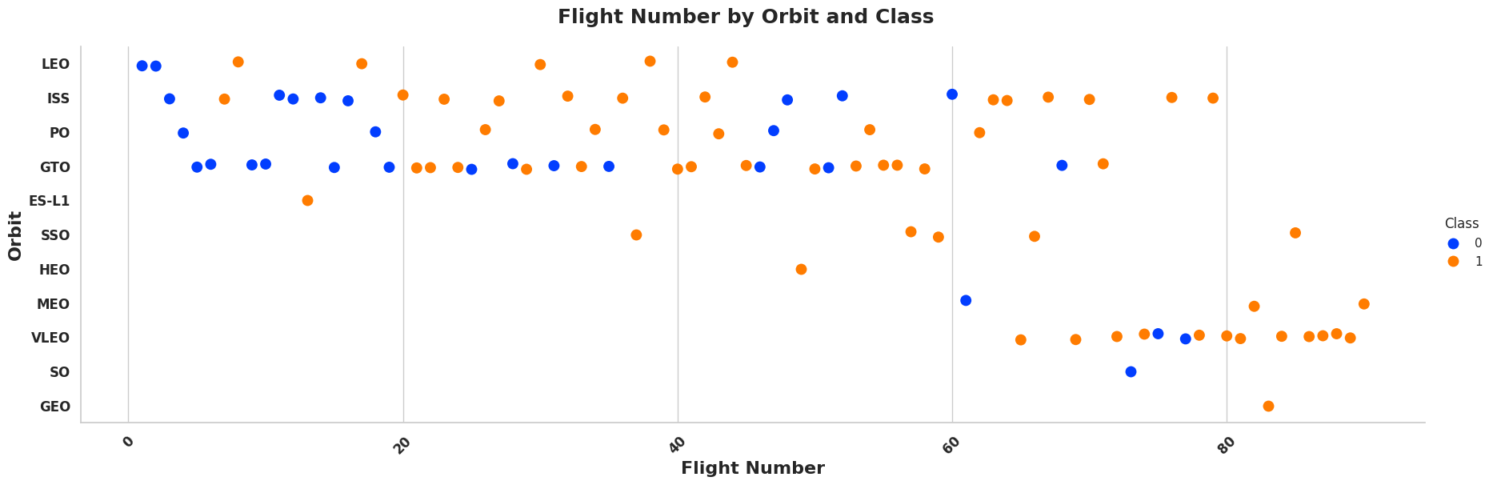
VISUALIZATION
FLIGHT NUMBER VS ORBIT TYPE
SpaceX started launches in LEO orbits where moderate success was found.
Most recent launches are mostly VLEO orbit thus SpaceX performs better in lower orbits.
It seems that LEOs success related is to flight number but GTO orbit breaks this relationship.
There was major success between flight 20 and ~45 in orbits LEO, ISS, PO.
Page 21

Slide 22
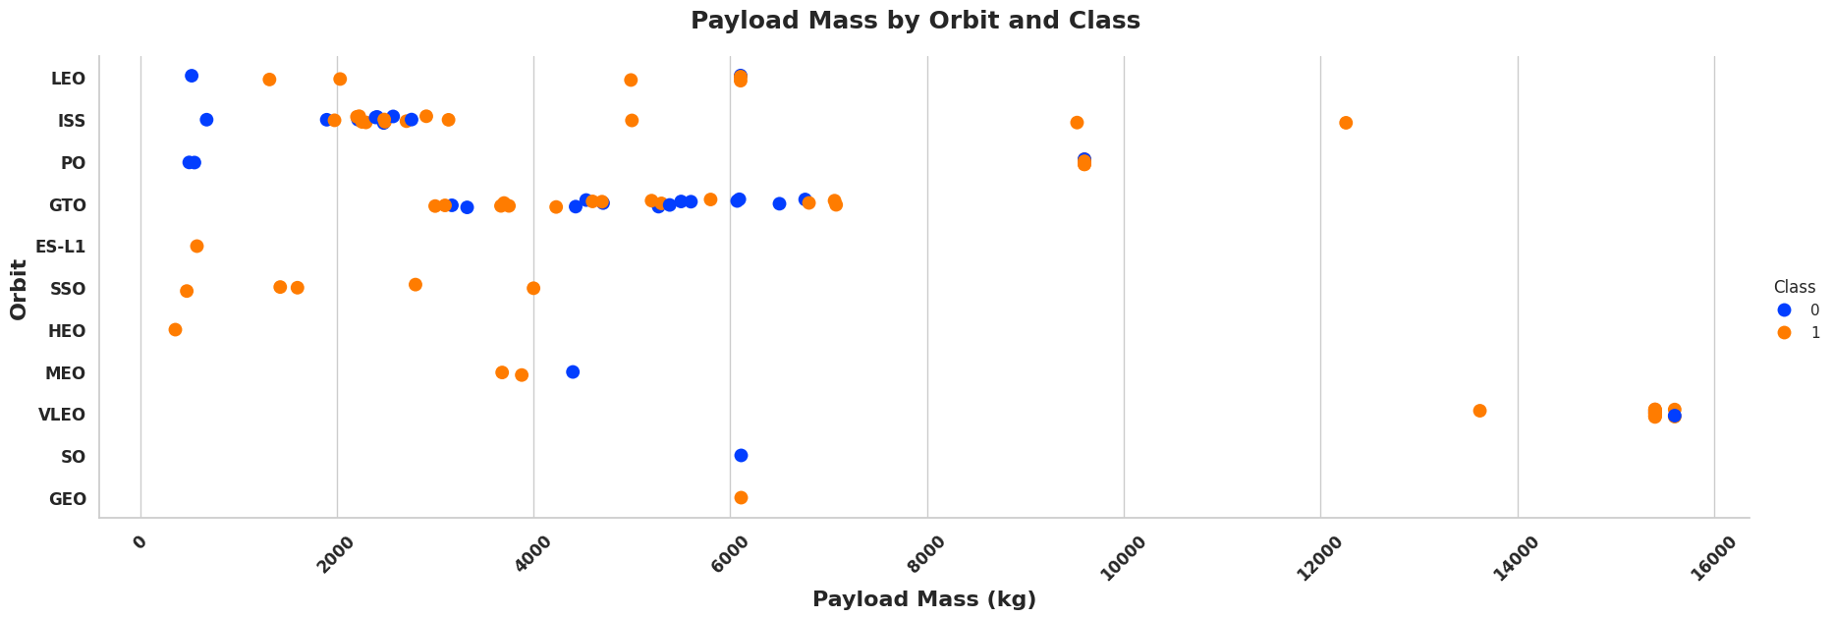
VISUALIZATION
PAYLOAD MASS VS ORBIT TYPE
LEO best performed with payload mass above ~1500kg.
Heavy payloads are better with LEO, ISS and PO orbits.
The GTO orbit has mixed success with heavier payloads thus a correlation cannot be made between payload mass and orbit type.
Page 22

Slide 23
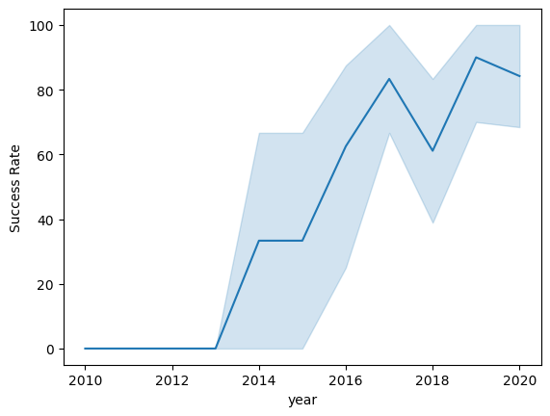
VISUALIZATION
LAUNCH SUCCESS YEARLY TREND
Success rate improved from 2013-2017 and 2018-2019.
Success rate decreased from 2017-2018 and 2019-2020.
Overall the success rate improved from 2013.
Page 23

Slide 24

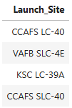
SQL
ALL LAUNCH SITE NAMES
Using DISTINCT in the query allows to show unique values in the Launch_Site column from the database.
Research about CCAF LC-40 and CCAFS SLC-40 concluded that they are the same launch site in Florida operated by different hosts, first the United states air force and then SpaceX. https://en.wikipedia.org/wiki/Cape_Canaveral_Space_Launch_Complex_40
Page 24

Slide 25
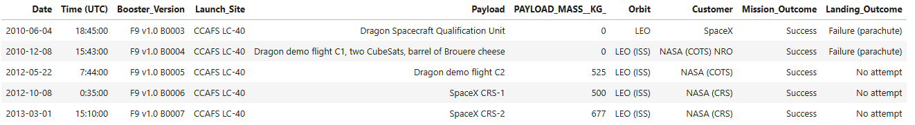
SQL
LAUNCH SITE NAMES BEGIN WITH ‘CCA’
First 5 entries in database with launch site name beginning with CCA. % - include anything after CCA.
Page 25

Slide 26

SQL
TOTAL PAYLOAD MASS FROM NASA
Total payload mass where NASA was a customer.
Page 26

Slide 27

SQL
AVERAGE PAYLOAD MASS BY F9 V1.1
Average payload mass of launches which used booster version F9 v1.1
Average payload mass is very low.
Page 27

Slide 28

SQL
FIRST SUCCESSFUL GROUND PAD LANDING DATE
First successful ground pad landing date.
Successful landings generally appear starting from 2014 as also indicated by the launch success vs year line graph.
Page 28

Slide 29
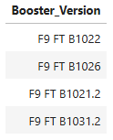
SQL
SUCCESSFUL DRONE SHIP LANDING WITH PAYLOAD BETWEEN 4000 AND 6000
Four booster versions that had successful drone ship landings and a payload mass between 4000 and 6000.
Page 29

Slide 30
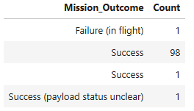
SQL
TOTAL NUMBER OF EACH MISSION OUTCOME (SUCCESS & FAILURE)
99 Success
1 Failure
1 Success (payload status unclear)
Page 30

Slide 31
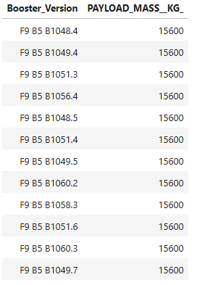
SQL
BOOSTERS THAT CARRIED MAXIMUM PAYLOAD
Booster versions that carried the highest payload mass of 15600kg.
All the boosters are of the F9 B% B10xx.x variety.
This indicates that payload mass correlates with the booster version that is used.
Page 31

Slide 32
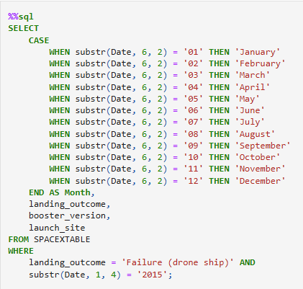

SQL
2015 FAILED DRONE SHIP LANDING RECORDS
2 occurrences where stage 1 of the launch failed.
Both are CCAFS LC-40 which is the 2nd most successful launch site.
They used the same booster version but earlier models, this is likely why they failed.
Page 32

Slide 33
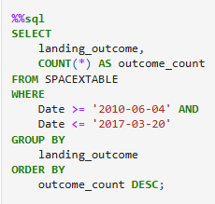
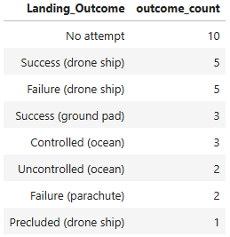
SQL
RANK LANDING OUTCOMES BETWEEN 2010-06-04 AND 2017-03-20
Landing outcomes between above dates.
Success type landings
drone ship
ground pad
controlled (ocean) -can be seen as fail
Failed landings/launch attempts
no attempt
drone ship
uncontrolled (ocean)
failure (parachute)
Precluded (drone ship)
There were 8 successful landings during the time period.
Page 33

Slide 34
LAUNCH SITES PROXIMITIES ANALYSIS
Page 34

Slide 35
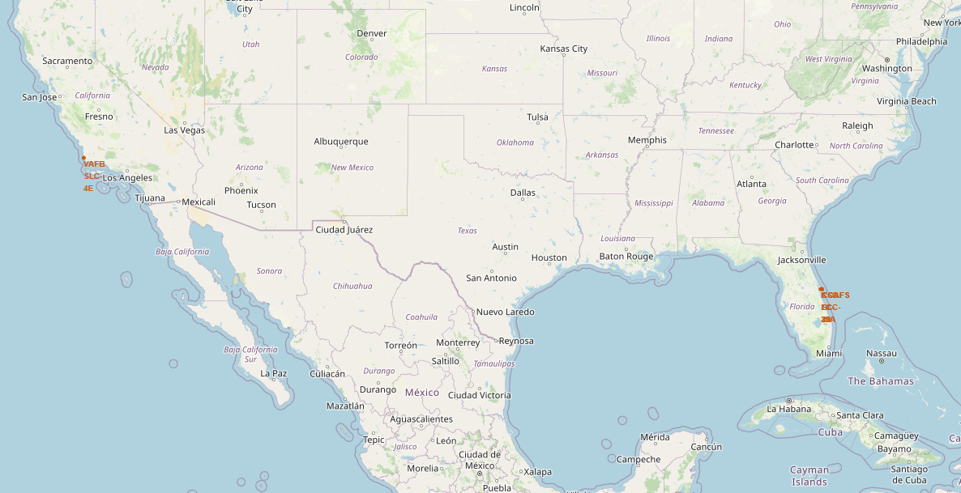
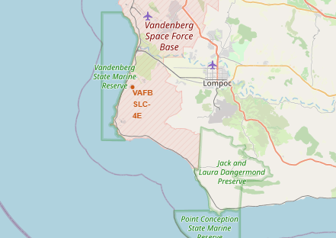
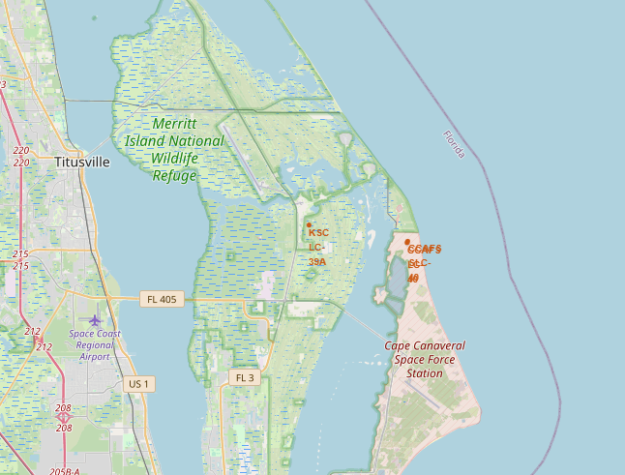
LAUNCH SITE LOCATIONS
SpaceX launch sites:
Florida and California
Page 35

Slide 36
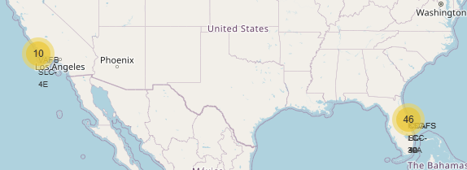
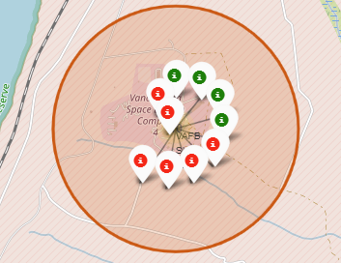
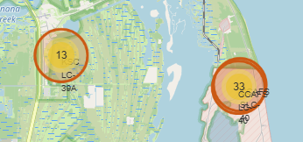
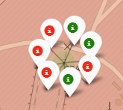
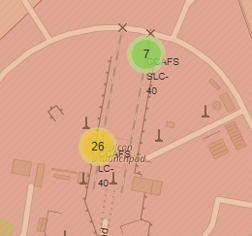
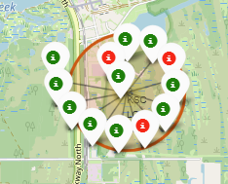
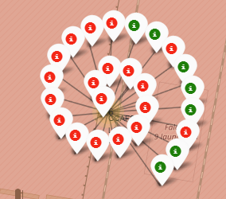
LAUNCH MARKERS
California Lunch Sites
Green - successful
Red - failures
Florida Launch Sites
Green - successful
Red - failures
Clusters can be clicked on to display each landing
Page 36

Slide 37
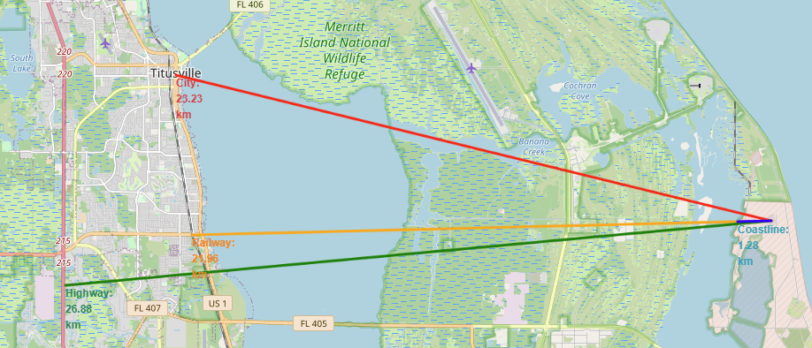
CCAFS SLC-40 & CCAFS LC-40 PROXIMITIES
Launch sites are not in close proximity to railways, highways or cities.
Launch sites are in close proximity to coastlines so that launch failures can land in the sea to avoid rockets falling on desensely populated areas like cities.
Page 37

Slide 38
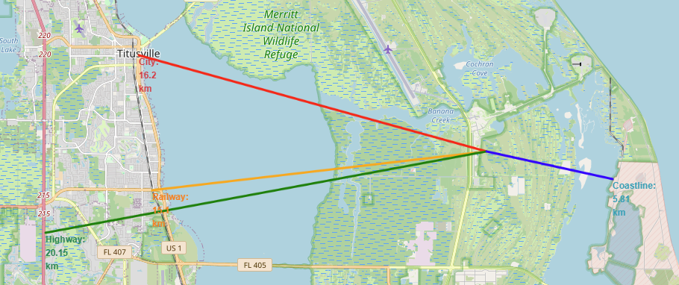
KSC LC-39A PROXIMITIES
Launch sites are not in close proximity to railways, highways or cities.
Launch sites are in close proximity to coastlines so that launch failures can land in the sea to avoid rockets falling on desensely populated areas like cities.
Page 38

Slide 39
BUILD A DASHBOARD WITH PLOTLY DASH
Page 39

Slide 40
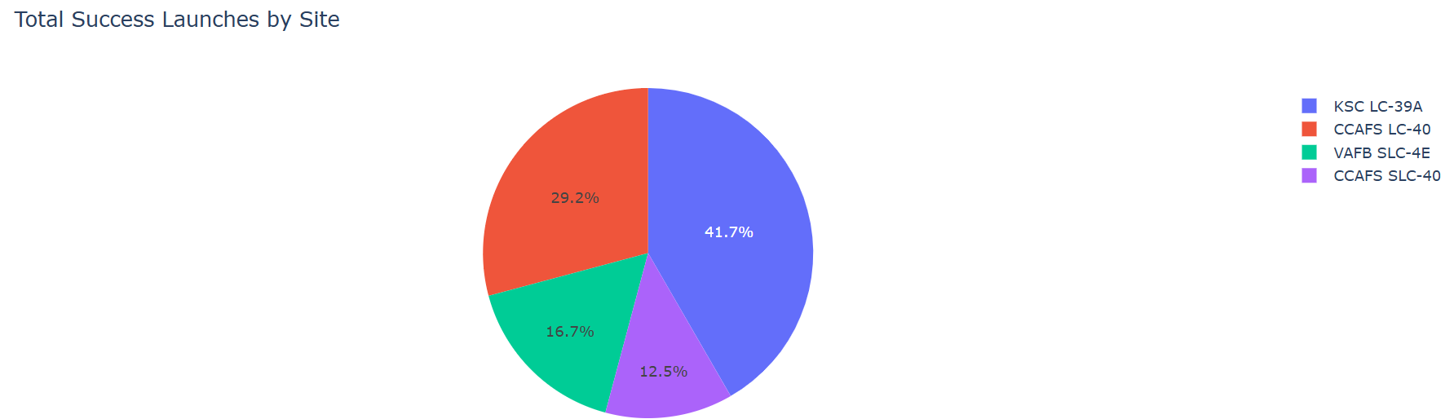
TOTAL SUCCESS LAUNCHES BY SITE
KSC LC-39A has the most successful launches
CCAFS SLC-40 least success
Page 40

Slide 41
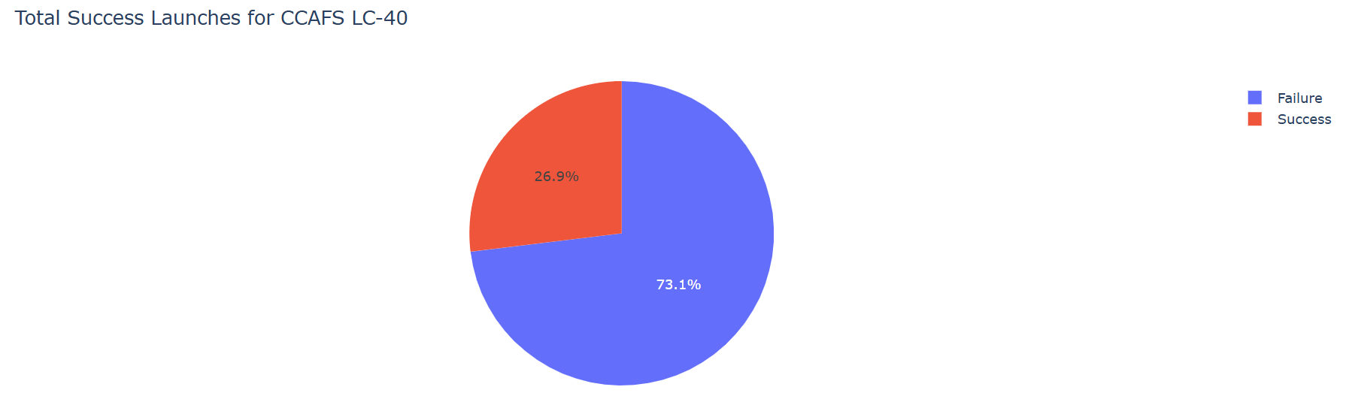

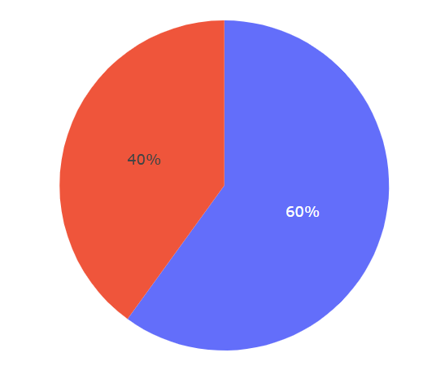
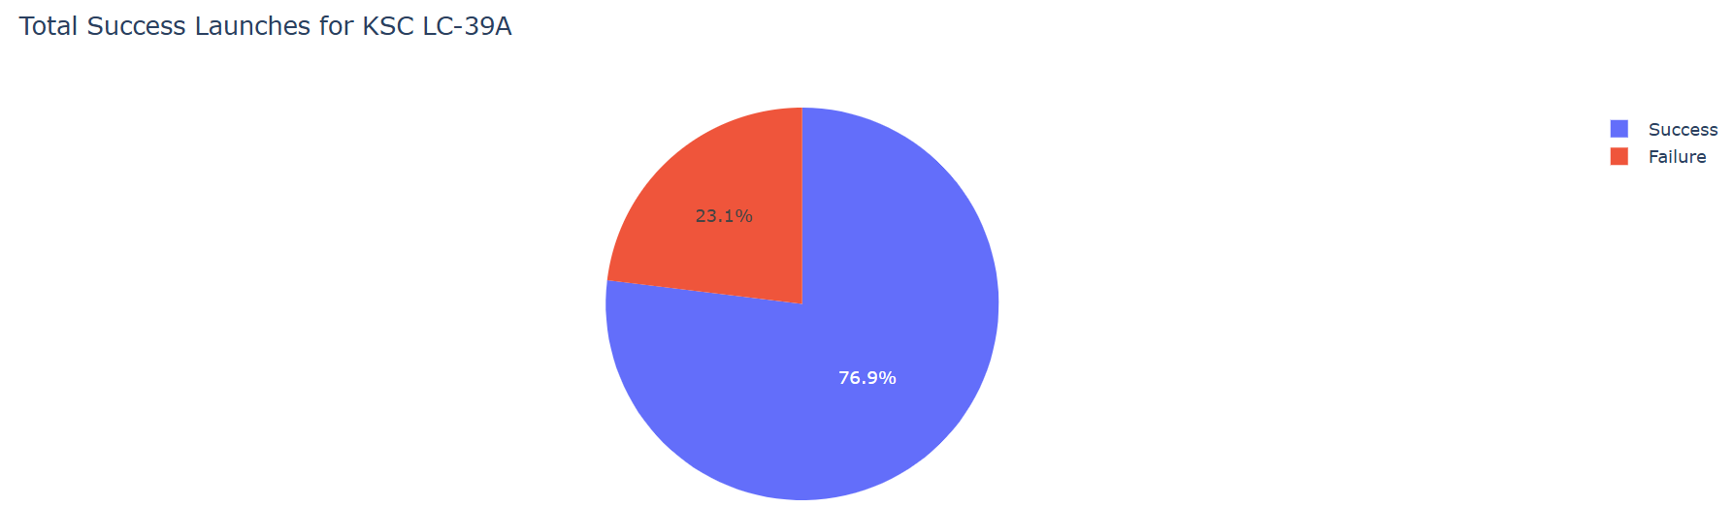
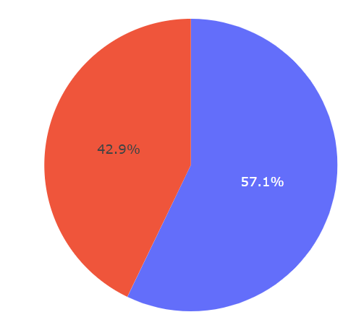
TOTAL SUCCESS LAUNCHES
CCAFS LC-40
VAFB SLC-4E
KSC LC-39A
VAFB SLC-4E
KSC LC-39A has the most successful launches
Page 41

Slide 42
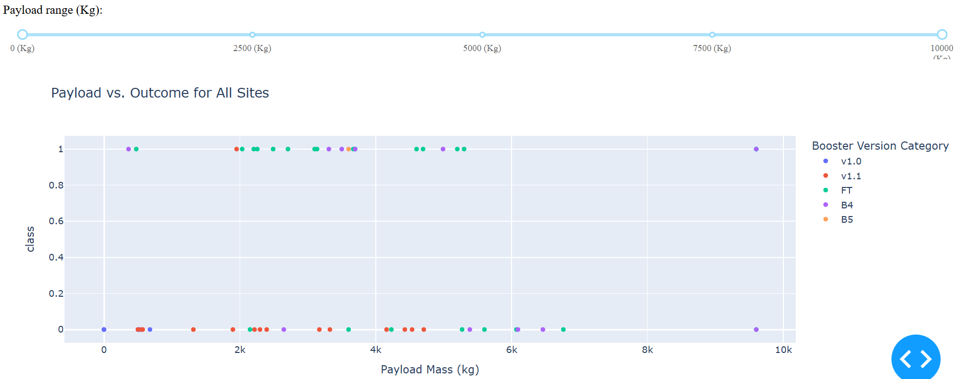
PAYLOAD VS OUTCOME FOR ALL SITES
More successful landings with payload mass of less than 5500kg.
Most successful boosters include FT and B4.
Boosters v1.0 and v1.1 doesn’t show positive results.
Class 1 - successful landing
Class 0 - failure
Booster versions shown in different colours
Page 42

Slide 43
PREDICTIVE ANALYSIS (CLASSIFICATION)
Page 43

Slide 44
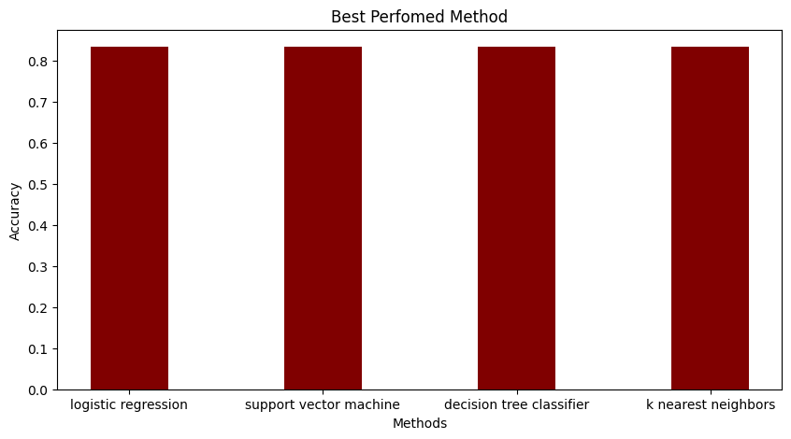
CLASSIFICATION ACCURACY
All models had the same accuracy if 83.33%
We likely need more data to determine the best model.
Looking at best performed method, the decision tree classifier is the best if we look down to the decimal.
Page 44

Slide 45
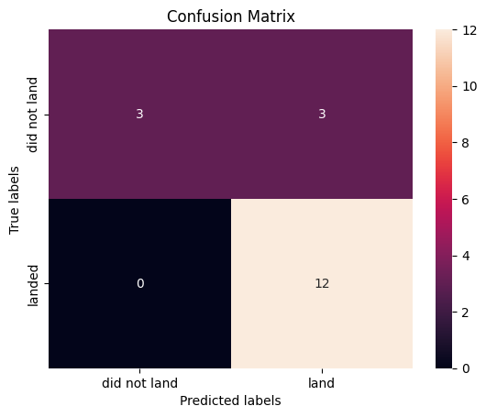
CONFUSION MATRIX
The model predicts 12 successful landings
Predicts 3 unsuccessful landings.
Predicts 3 successful landing (false positive)
Thus our model over predicts successful landings and our major problem is false positives.
Page 45

Slide 46
CONCLUSION
We developed a machine learning model for Space Y to predict whether the Falcon 9 first stage will land successfully based on historical data and launch parameters.
Used SpaceX API and Web Scraping techniques to retrieve data.
Wrangled data to get needed sources and used data visualization and SQL to retrieve needed information and create relevant graphs to conclude on relationships between parameters.
Machine learning model created with 83.33% accuracy.
The decision tree classifier is the best for machine learning for this dataset.
KSC LC -39A had the most successful launches out of all the sites.
Orbit ES-L1, GEO, HEO, SSO has the best success rate.\
Space Y can predict with a relevantly high accuracy whether a launch will have a successful stage 1 landing, to determine whether the launch should be made or not.
More data should be collected to better determine the best model for machine learning model to improve accuracy
Page 46

Slide 47
APPENDIX
Github repository url:
https://github.com/Ankedefrey/Data-Science-Capstone-Project
Page 47

